Slide 1

PYTHON
POLYMORPHISM

Slide 2

OBJECTIVES
About Polymorphism
Different ways of polymorphism

Slide 3
POLYMORPHISM
Polymorphism is the ability of an object to take many forms
It also refers to performing the same operation in multiple or different ways.

Slide 4
APPLICATION OF POLYMORPHISM
Polymorphism in built in function.
Polymorphism with inheritance.
Polymorphism with classes.
Polymorphism in function and object.

Slide 5
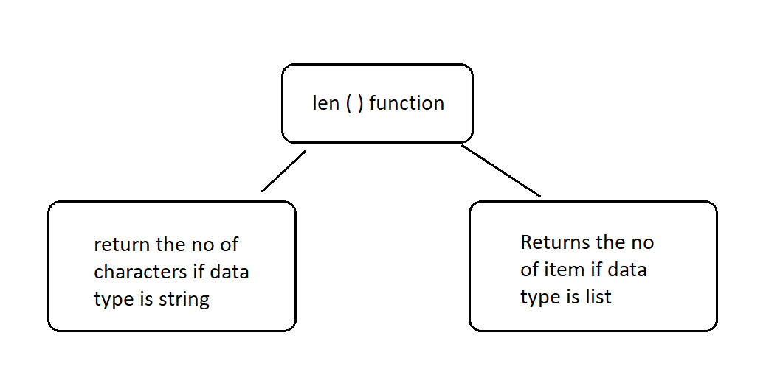
POLYMORPHISM IN BUILT IN FUNCTION

Slide 6
POLYMORPHISM WITH INHERITANCE
Polymorphism is often used with the inheritance
The same method defined in the parent class when defined in the child class will override the definition defined in its parent class counterpart.

Slide 7
POLYMORPHISM WITH CLASSES
The same method defined in different classes will behave differently according to their definition this happens because python first checks the class of the object and then its relevant method.

Slide 8
POLYMORPHISM WITH FUNCTION AND OBJECT
The same function would behave differently according to the type of our object.

